Slide 1
Systems Analysis and Design, 2nd Edition
Alan Dennis and Barbara Haley Wixom
John Wiley & Sons, Inc.
Slides by Roberta M. Roth
University of Northern Iowa

Slide 2
Architecture Design
Chapter 9

Slide 3


Key Definitions
Architecture design
  Plans for how the system will be distributed across computers and what the hardware and software will be used for each computer
Hardware and software specification
  Describes the hardware/software components in detail to aid those responsible for purchasing those products.

Slide 4
ELEMENTS OF AN ARCHITECTURE DESIGN

Slide 5
Architectural Components (Functions) of Software
Data storage
Data access logic
  Processing required to access stored data
Application logic
  Processing logic of the application
Presentation logic
  Information display and user command processing

Slide 6

Architectural Design Purpose
Determine what parts of the application software will be assigned to what hardware.
Hardware options:
  Clients
    Input/output devices employed by users
    PCs, laptops, handheld devices, cell phones
  Servers
    Larger computers storing software
    Accessible by many users

Slide 7
Alternative Servers
Mainframe
Minicomputer
Microcomputer (personal computer)

Slide 8
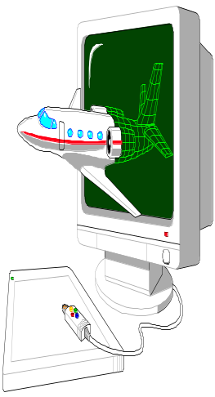
Alternative Clients
Terminals
Microcomputer (personal computer)
Special purpose terminals(ATMs, kiosks, Palm Pilots, and many others)

Slide 9
Architecture Choices
Server-based Architecture
Client-based Architecture
Client-server based Architecture

Slide 10
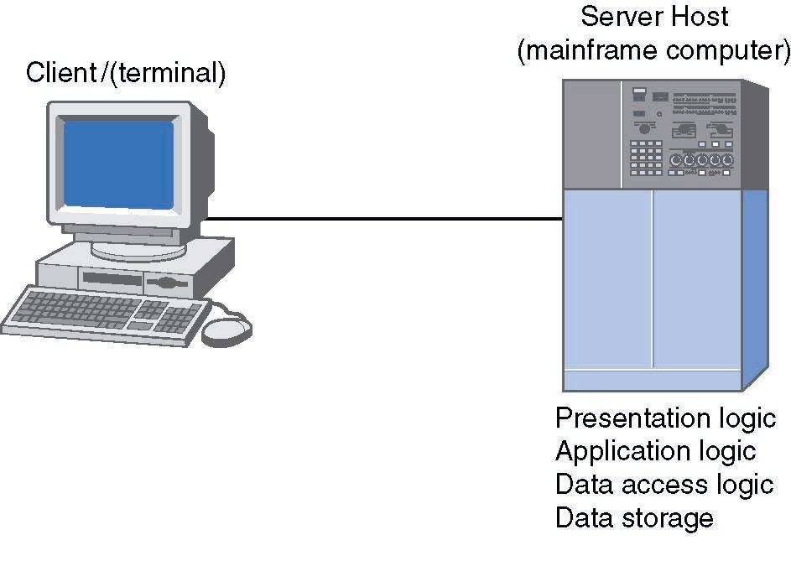
Server-Based Architecture

Slide 11
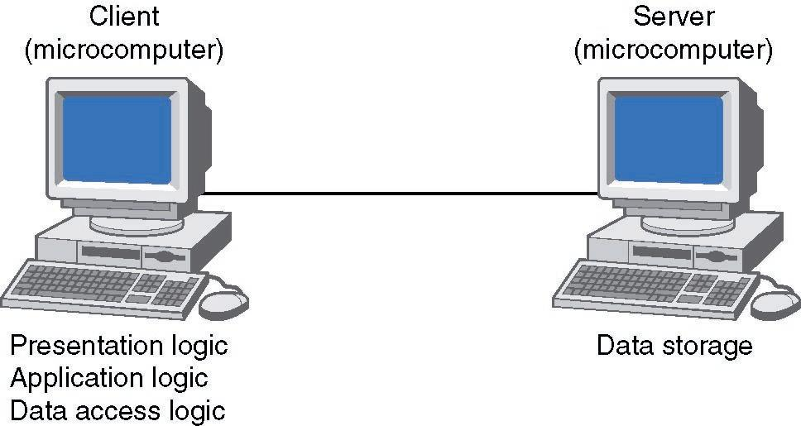
Client-Based Architecture

Slide 12
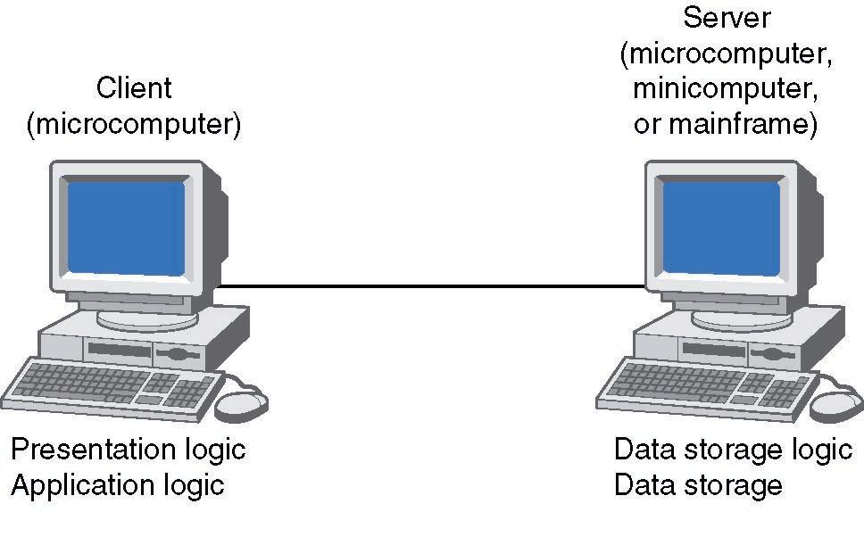
Client-Server Architecture (Two-Tiered)

Slide 13
Client-Server Attributes
Benefits
  Scalable
  Works with multiple vendors/products through middleware
  Improved modularity of web-based systems
  No central point of failure
Limitations
  Complexity
  New programming languages and techniques (adds stress for personnel)
  More complex to update

Slide 14
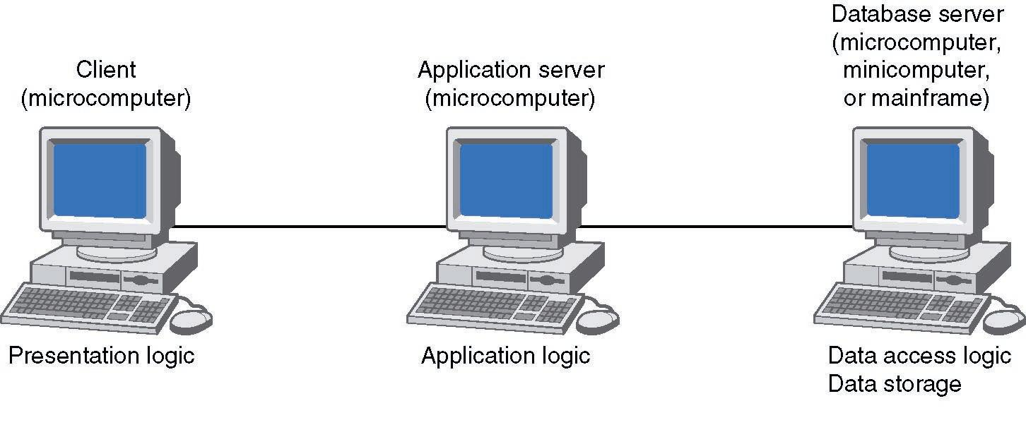
Three-Tiered Client-Server Architecture

Slide 15
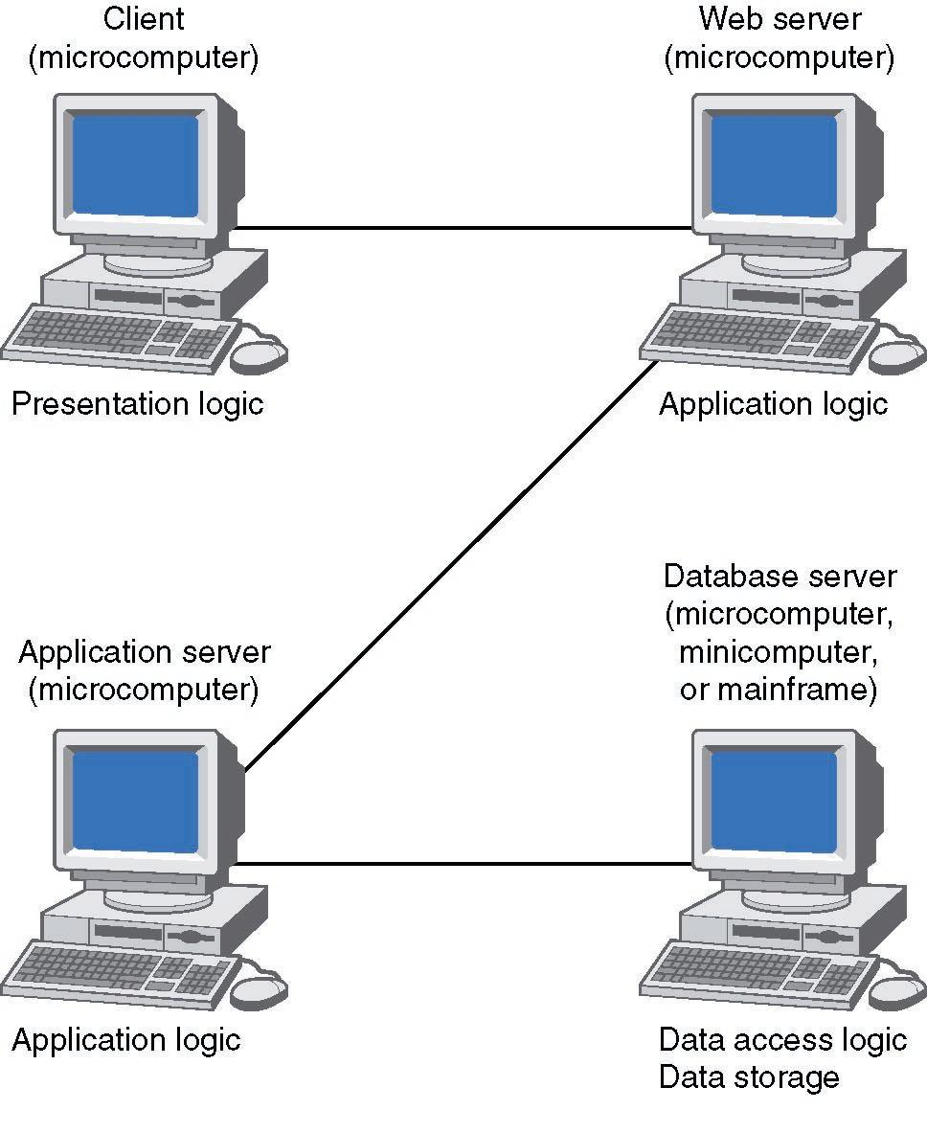
Four-Tiered Client-Server Architecture

Slide 16
N-Tiered versus 2-Tiered Client-Server Architectures
Benefits
  Separates processing to better balance load on different servers
  More scalable
Limitations
  Greater load on the network
  More difficult to program and test

Slide 17
Your Turn
Consider the course registration system at your university:
What computing architecture does it use?
What computing architecture would you use if you were replacing it today?

Slide 18
CREATING AN ARCHITECTURE DESIGN

Slide 19
Selecting an Architecture Design
Lower costs often used to justify choice of client-server
Recommended selection process:
  Expand nonfunctional requirement details
  Base architecture selection on the detailed nonfunctional requirements

Slide 20
Operational Requirements
Requirement | Definition | Example
Technical Environment | Special hardware, software, and network requirements imposed by business requirements | Always-on network connection permitting real-time database updates
System Integration | The extent to which the system will operate with other systems | The system will read and write to the main inventory database
Portability | The extent to which the system will need to operate in other environments | The system may need to operate with handheld devices
Maintainability | Expected business changes to which the system should be able to adapt | The system must accommodate new manufacturing plants

Slide 21
Performance Requirements
Requirement | Definition | Example
Speed | Time within which the system must perform its function | Network transaction response time <= 7 seconds
Capacity | Total and peak number of users and the volume of data expected | Maximum of 100-200 simultaneous users at peak times
Availability and Reliability | Extent to which the system will be available to the users and the permissible failure rate due to errors | 99% uptime performance

Slide 22
Security Requirements
Requirement | Definition | Example
System Value Estimates | Estimated business value of the system and its data | A complete loss of all system data would cost $20 million
Access Control | Limitations on who can access what data | Inventory changes can be made only by department managers
Encryption and Authentication | Defines what data will be encrypted where and whether authentication will be needed for user access | Data will be encrypted from the user’s computer to the Web site to provide secure ordering
Virus Control | Controls to limit viruses | All uploaded files will be checked for viruses before being saved in the system

Slide 23
Cultural/Political Requirements
Requirement | Definition | Example
Multilingual | The language(s) the system users will need | The system will operate in English, French, and Spanish
Customization | Specification of what aspects of the system can be changed by local users | Country managers will be able to define new fields in the product database to capture country-specific information
Making Unstated Norms Explicit | Explicitly stating assumptions that differ from country to country | All weights will be stated in kilograms
Legal | The laws and regulations that impose system requirements | Personal customer information cannot be transferred from European Union countries to US

Slide 24
Designing the Architecture
Technical environment requirements, driven by business requirements, often define the application architecture
If not, other nonfunctional requirements become important

Slide 25
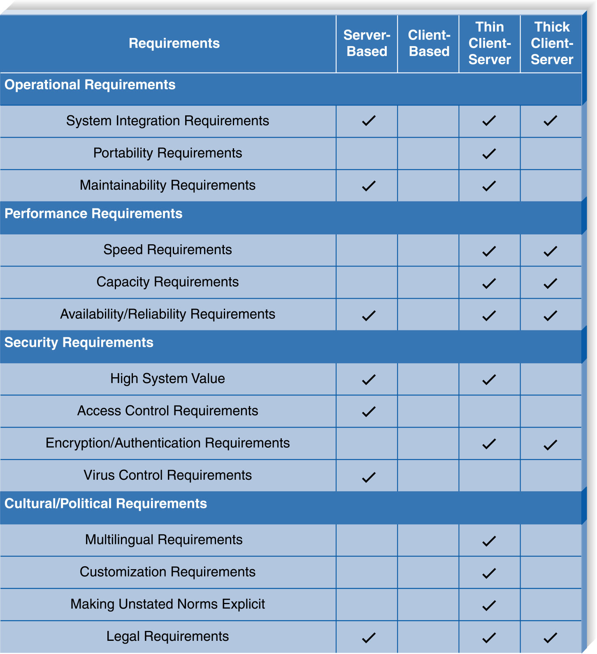
Nonfunctional Requirements and the Architecture Design

Slide 26
HARDWARE AND SOFTWARE SPECIFICATION

Slide 27
Hardware and Software Specification
Used if new hardware or software must be purchased
Communicates project needs
Actual acquisition of hardware and software usually left to a purchasing department -- especially in larger firms

Slide 28
Hardware and Software Specification
Determine software needs
  OS, special purpose
  Training, warranty, maintenance, licensing needs
Determine hardware needs
  Server(s), clients, peripherals, backup devices, storage components
  Minimum configuration needs

Slide 29
Summary
The three fundamental computing architectures are server-based, client-based, and client-server based.
Select architecture design based on detailed nonfunctional requirements
Hardware and software specification documents acquisition needs

Slide 30
Copyright © 2003
John Wiley & Sons, Inc.
All rights reserved. Reproduction or translation of this work beyond that permitted in Section 117 of the 1976 United States Copyright Act without the express written permission of the copyright owner is unlawful.
Request for further information should be addressed to the Permissions Department, John Wiley & Sons, Inc.
The purchaser may make back-up copies for his/her own use only and not for redistribution or resale.
The Publisher assumes no responsibility for errors, omissions, or damages, caused by the use of these programs or from the use of the information contained herein.

